Slide 1
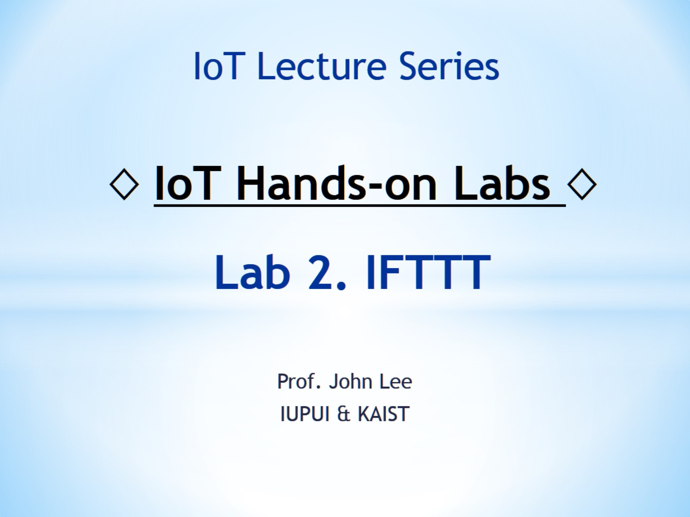
◊ IoT Hands-on Labs ◊ Lab 2. IFTTT

Slide 2
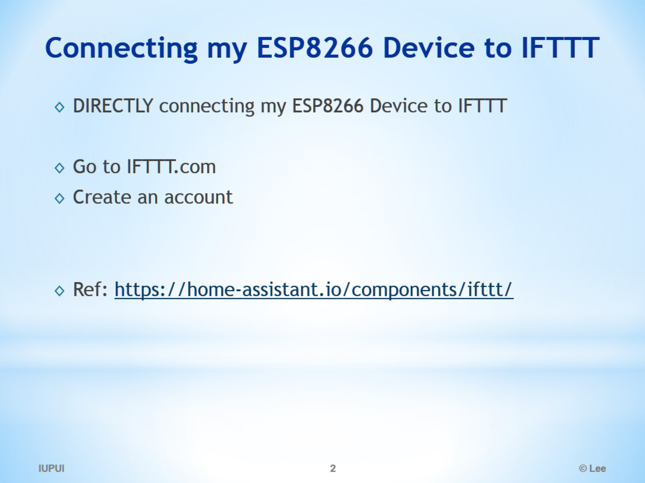
Connecting my ESP8266 Device to IFTTT

Slide 3
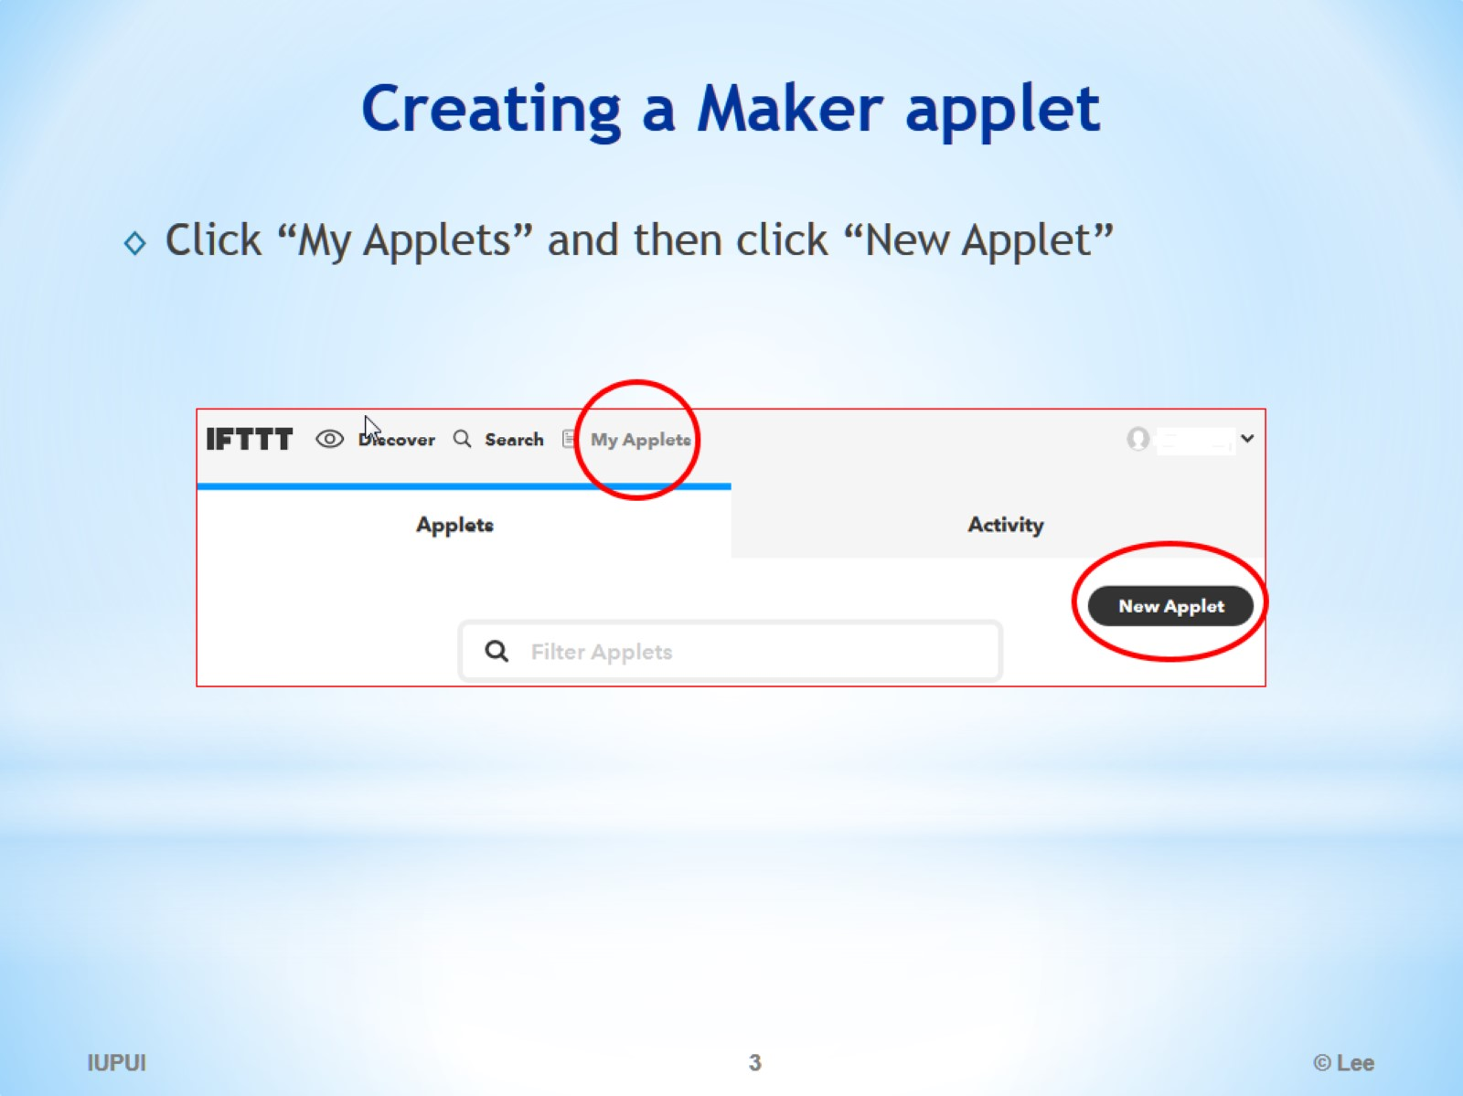
Creating a Maker applet

Slide 4
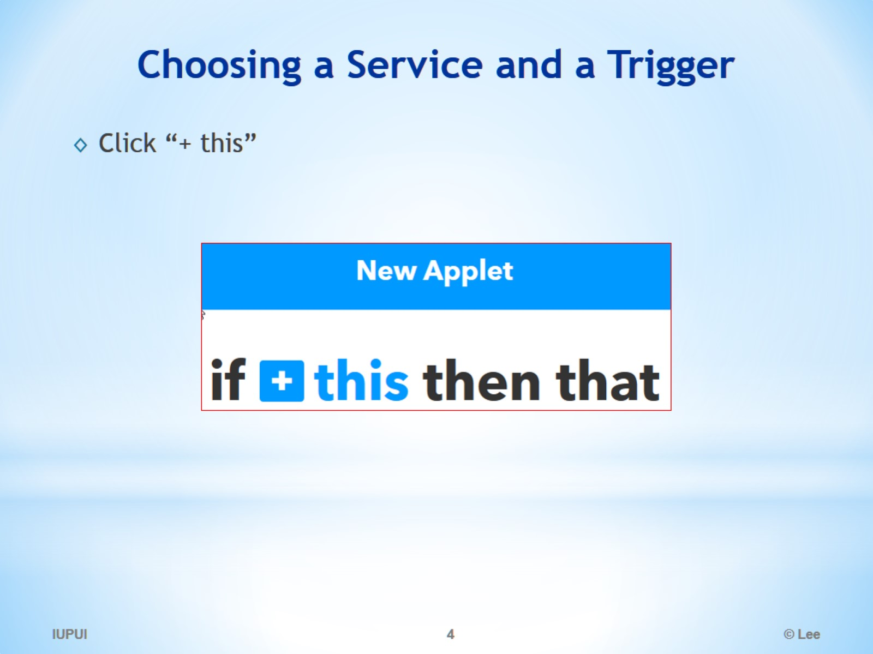
Choosing a Service and a Trigger

Slide 5
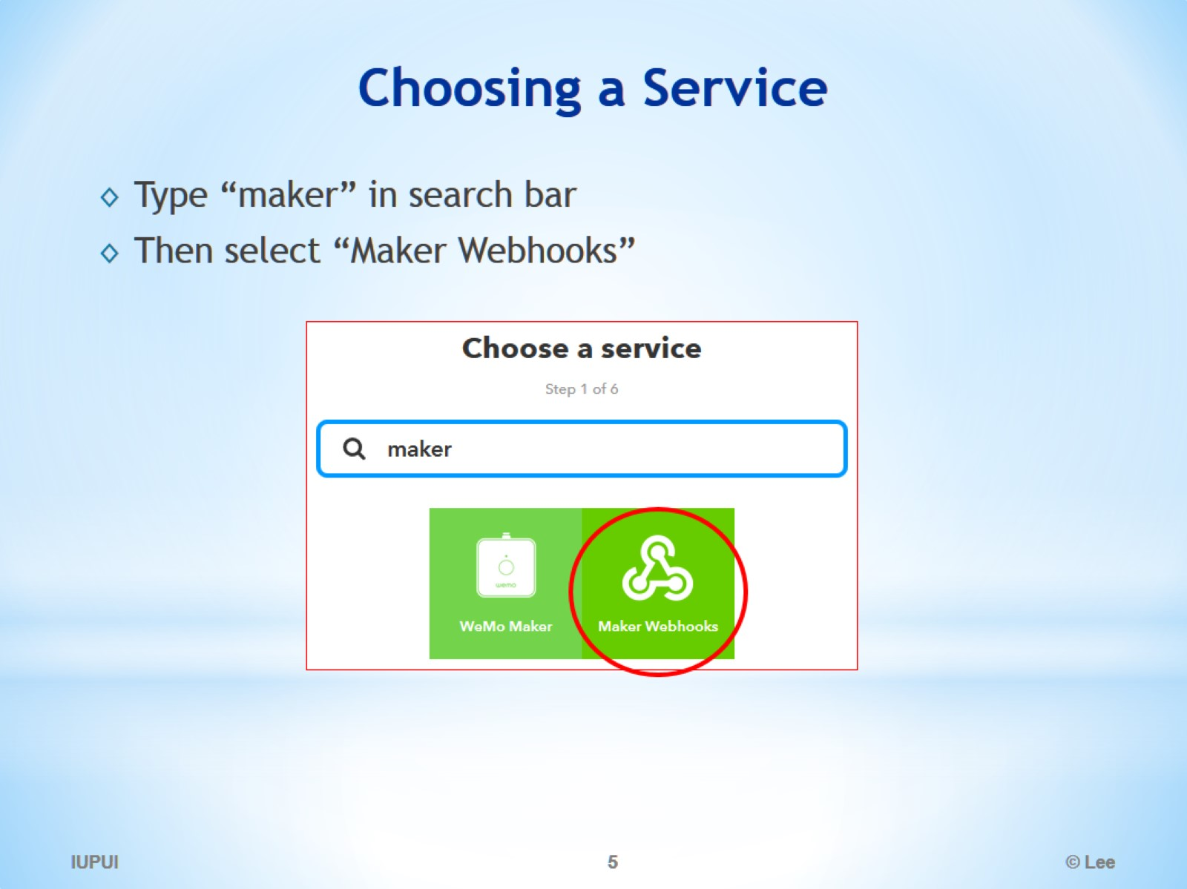
Choosing a Service

Slide 6
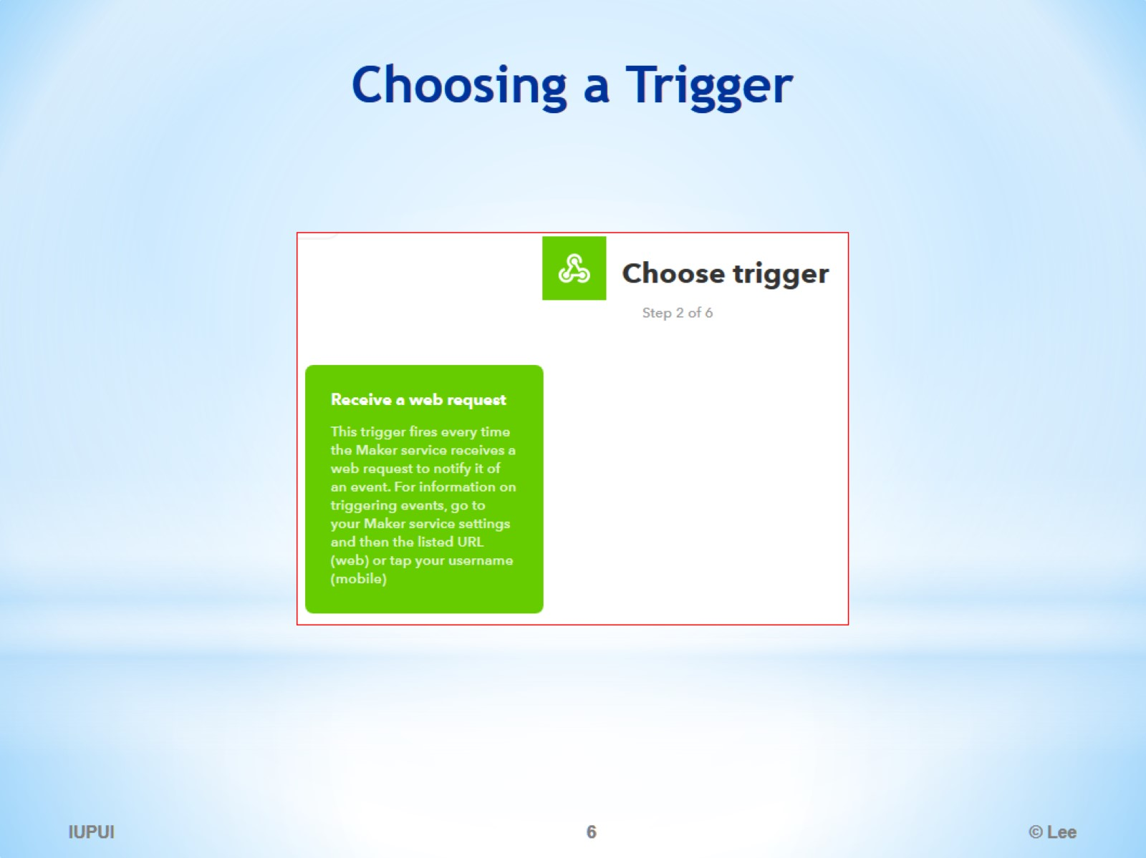
Choosing a Trigger

Slide 7
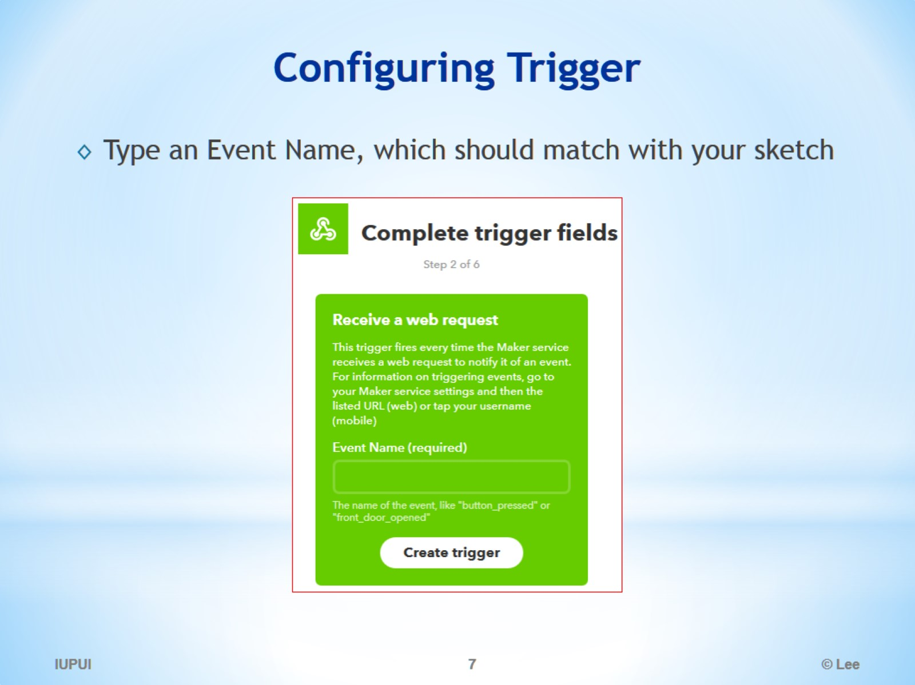
Configuring Trigger

Slide 8
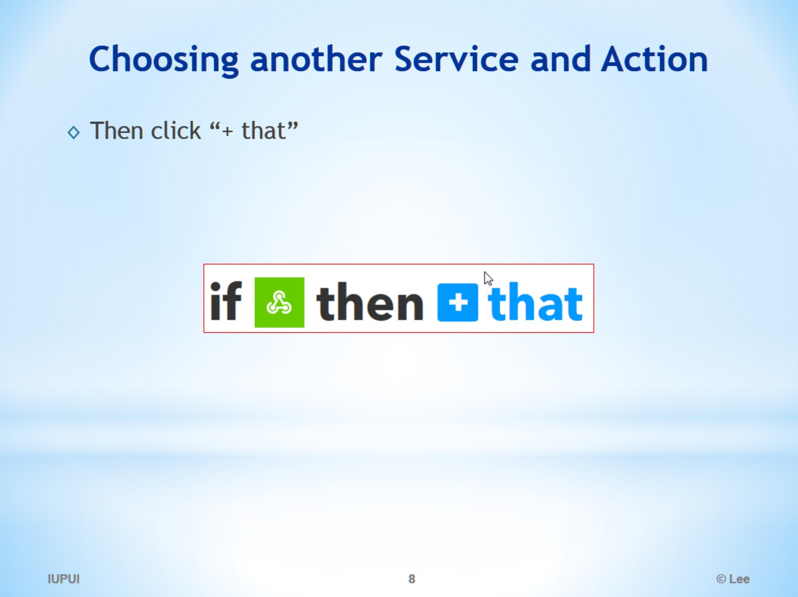
Choosing another Service and Action

Slide 9
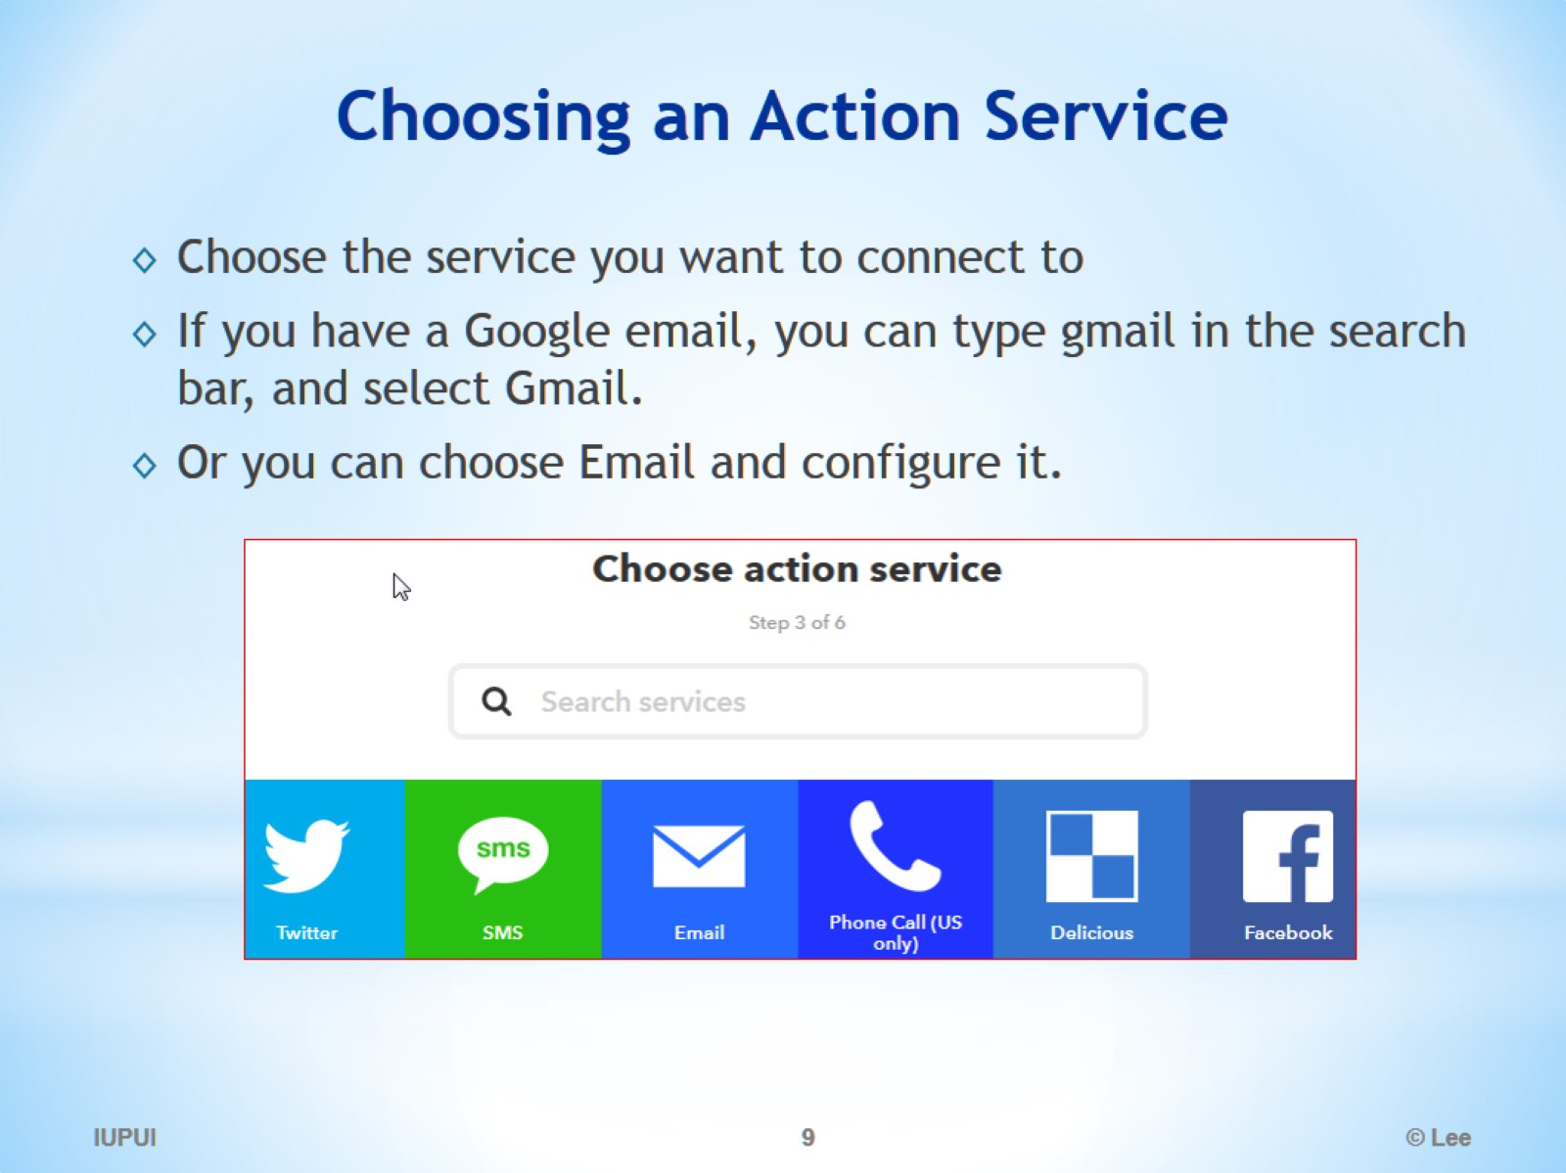
Choosing an Action Service

Slide 10
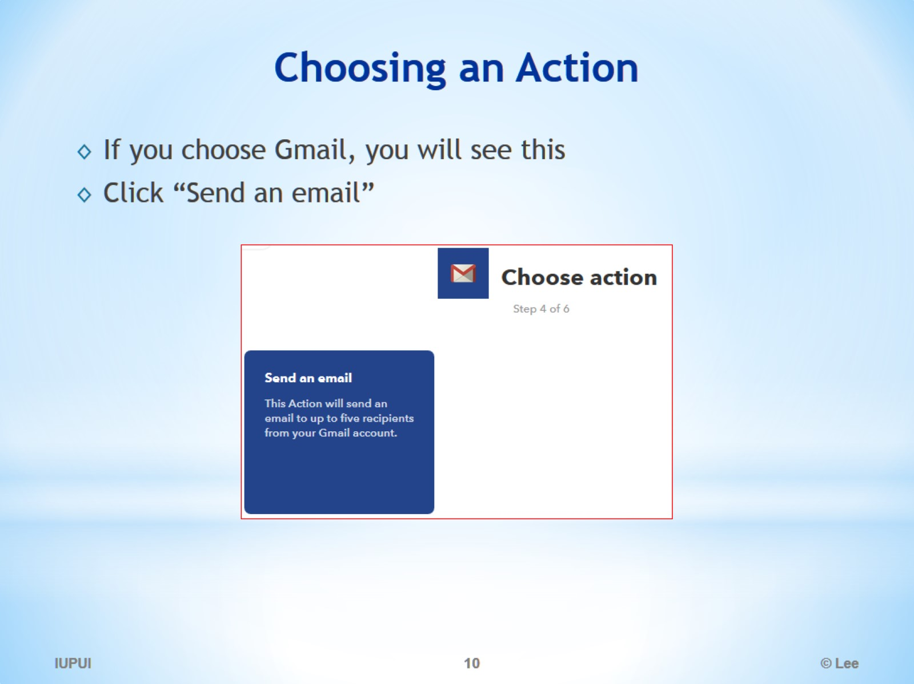
Choosing an Action

Slide 11
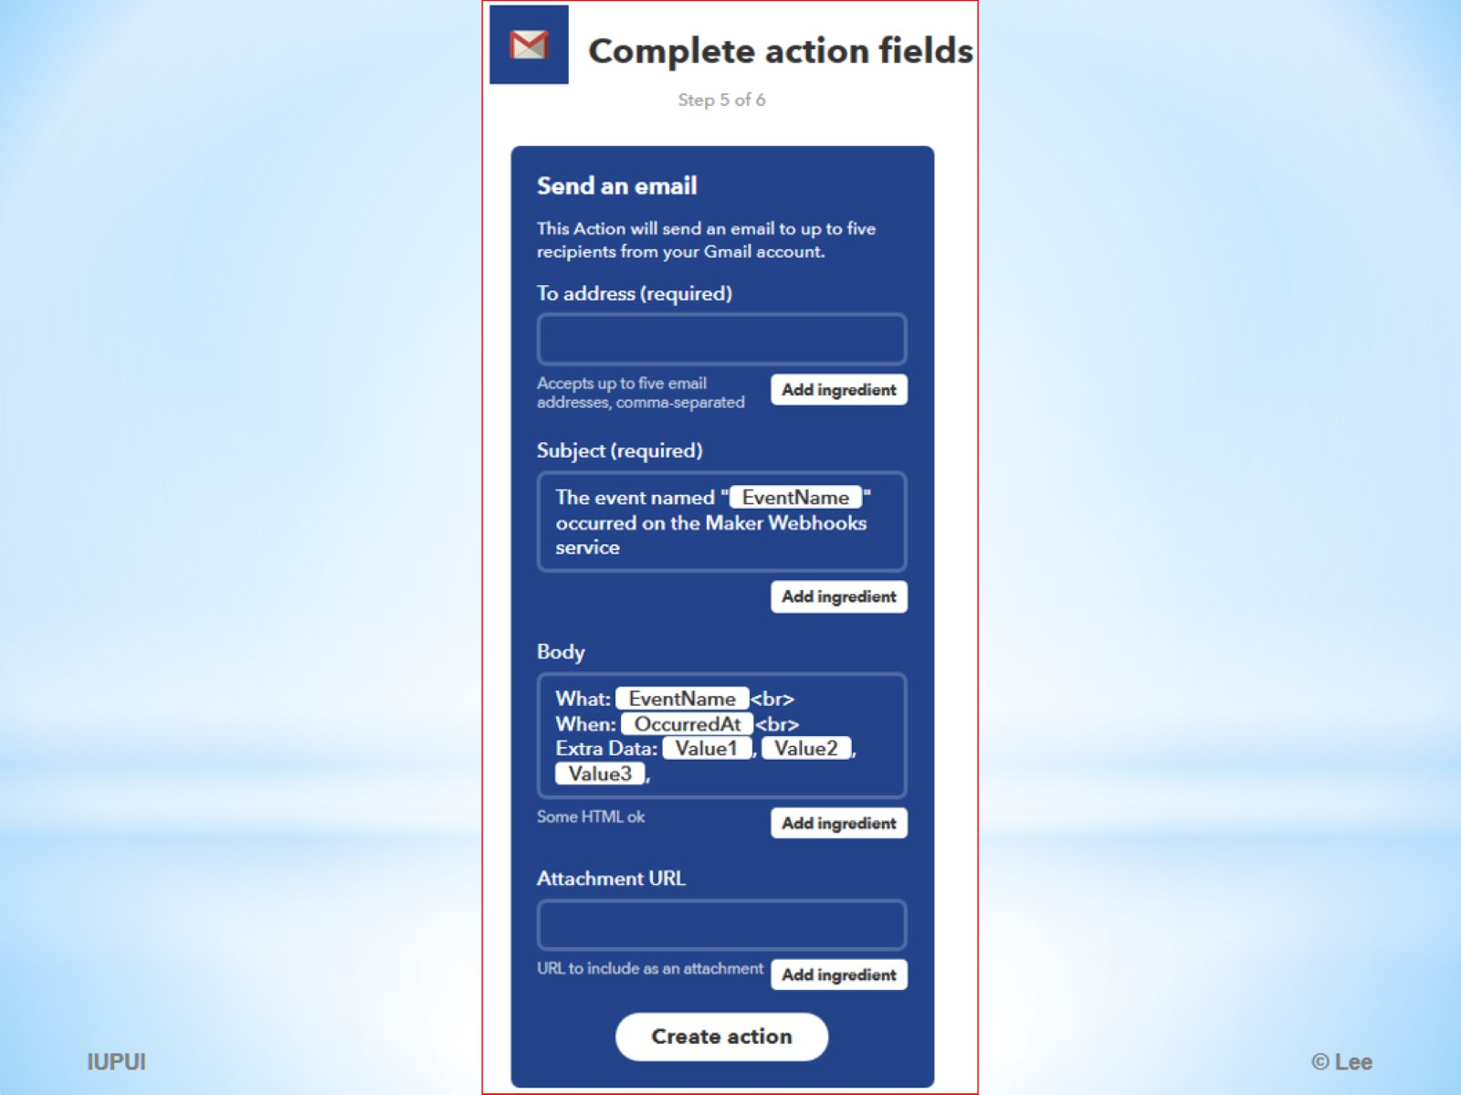

Slide 12
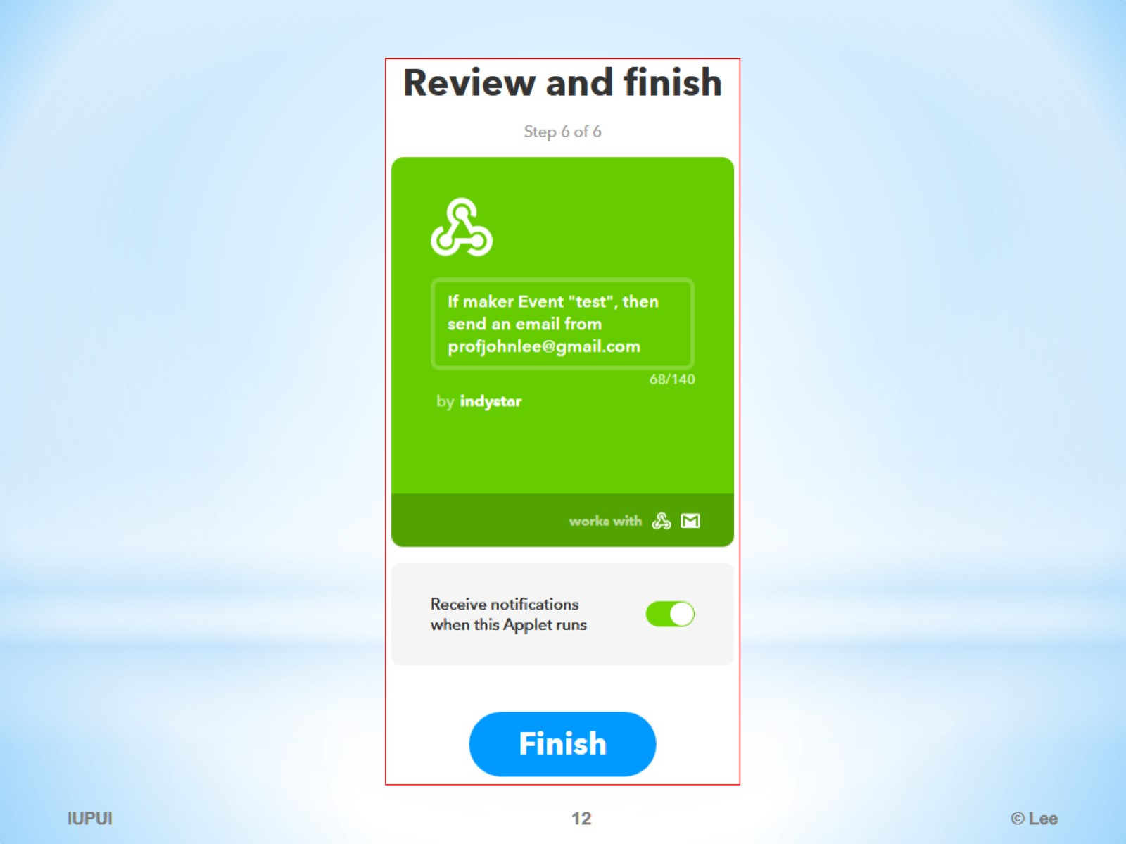

Slide 13
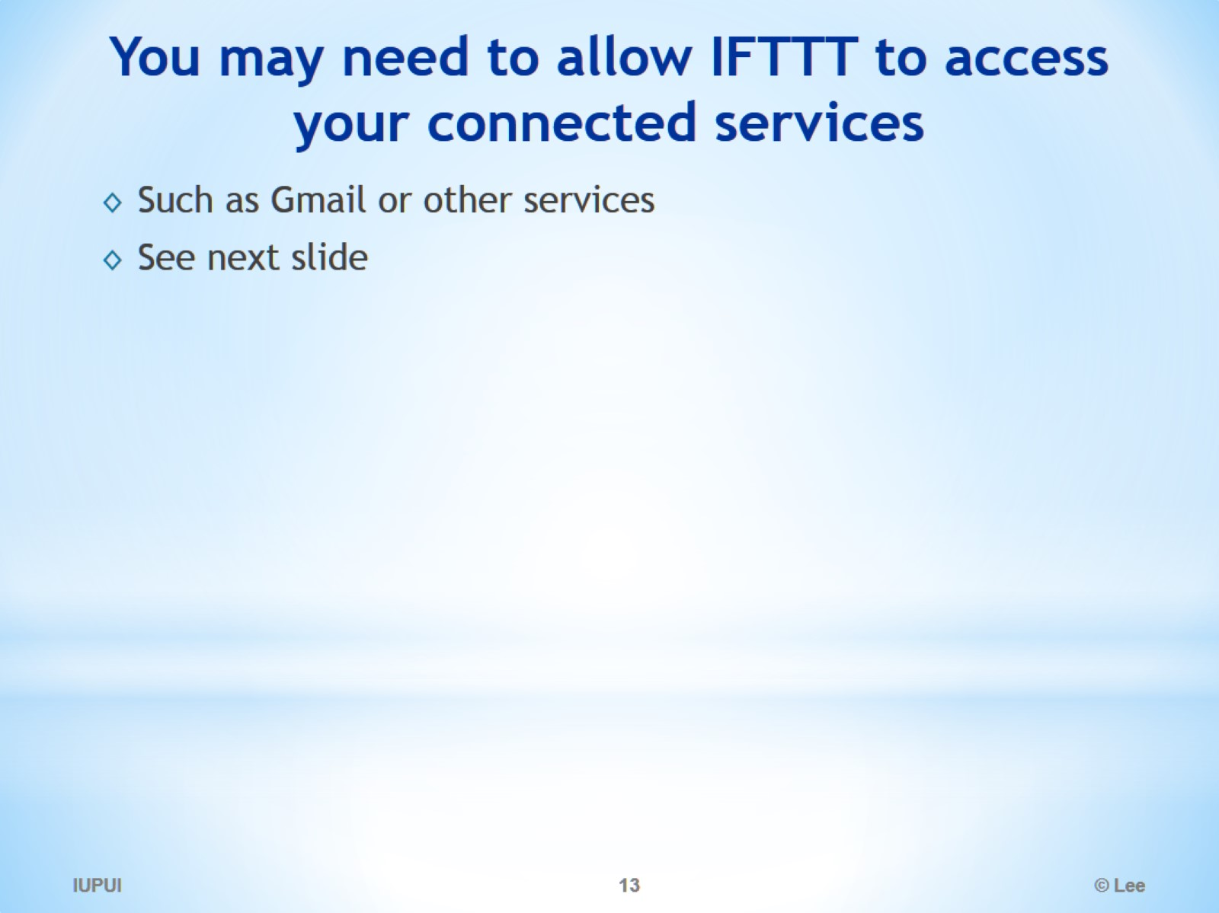
You may need to allow IFTTT to access your connected services

Slide 14
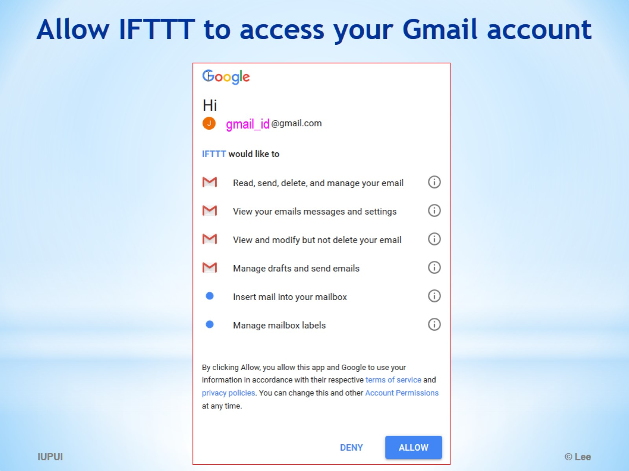
Allow IFTTT to access your Gmail account

Slide 15
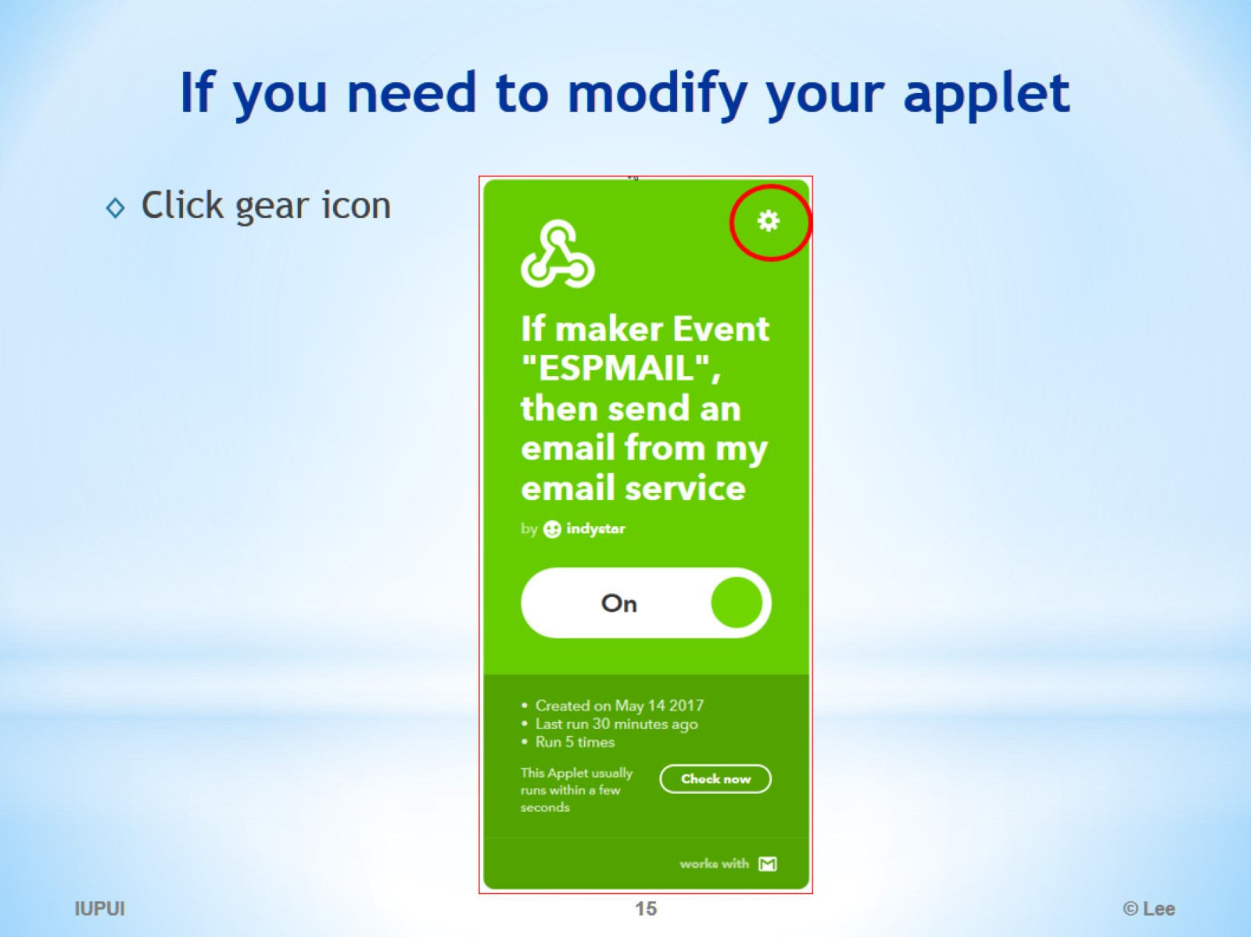
If you need to modify your applet

Slide 16
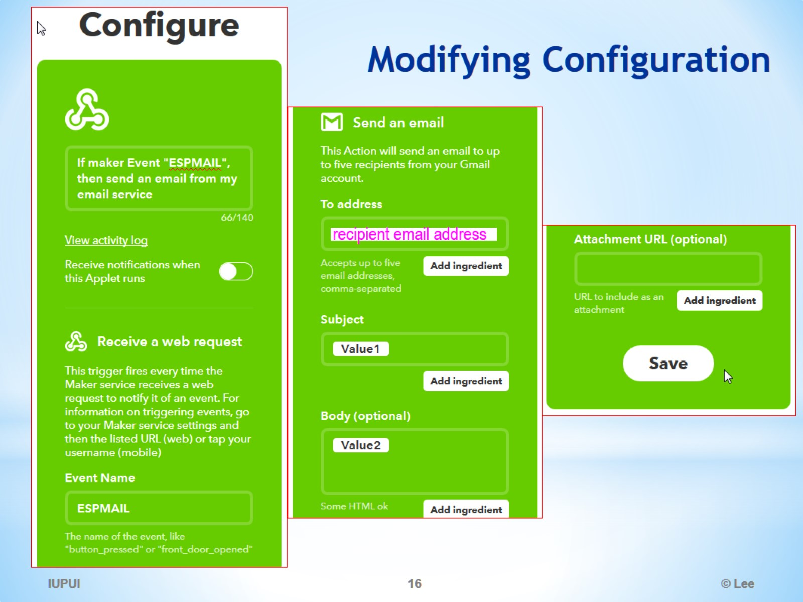
Modifying Configuration

Slide 17
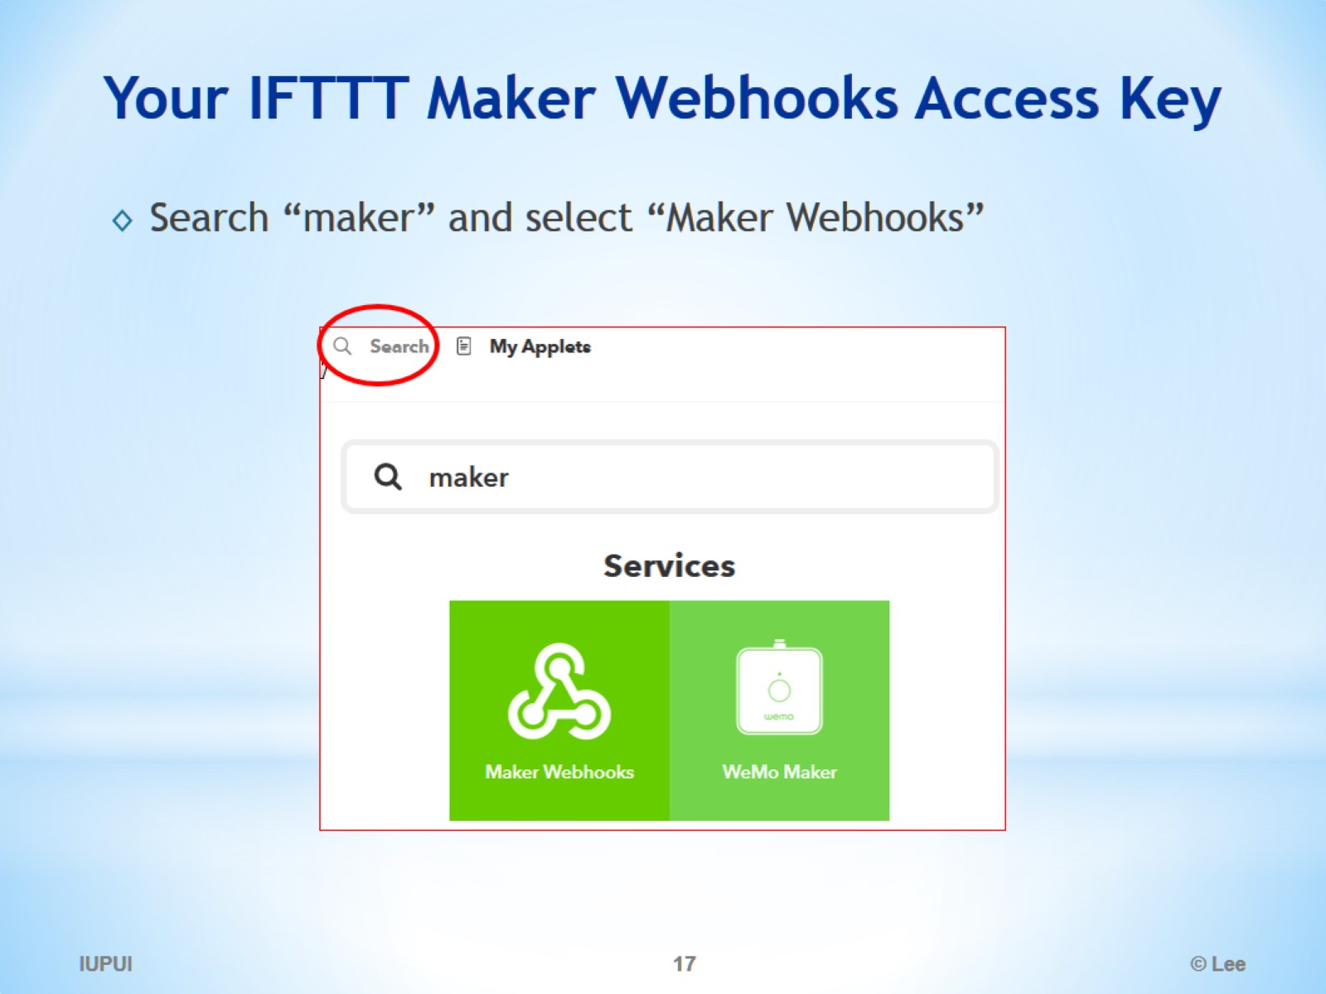
Your IFTTT Maker Webhooks Access Key

Slide 18
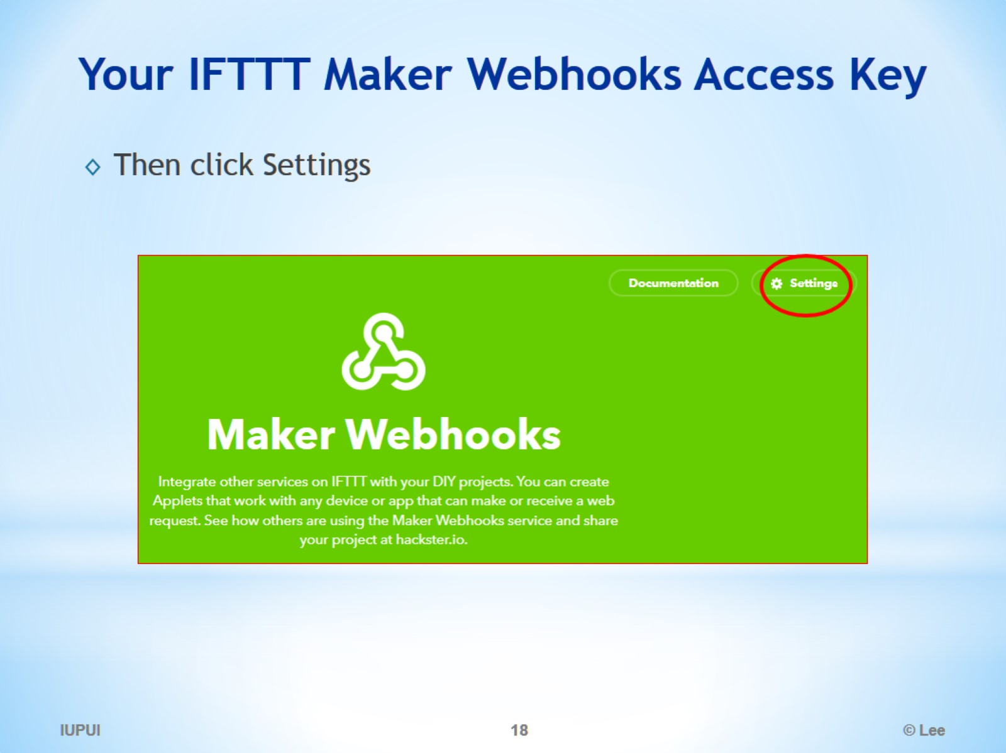
Your IFTTT Maker Webhooks Access Key

Slide 19
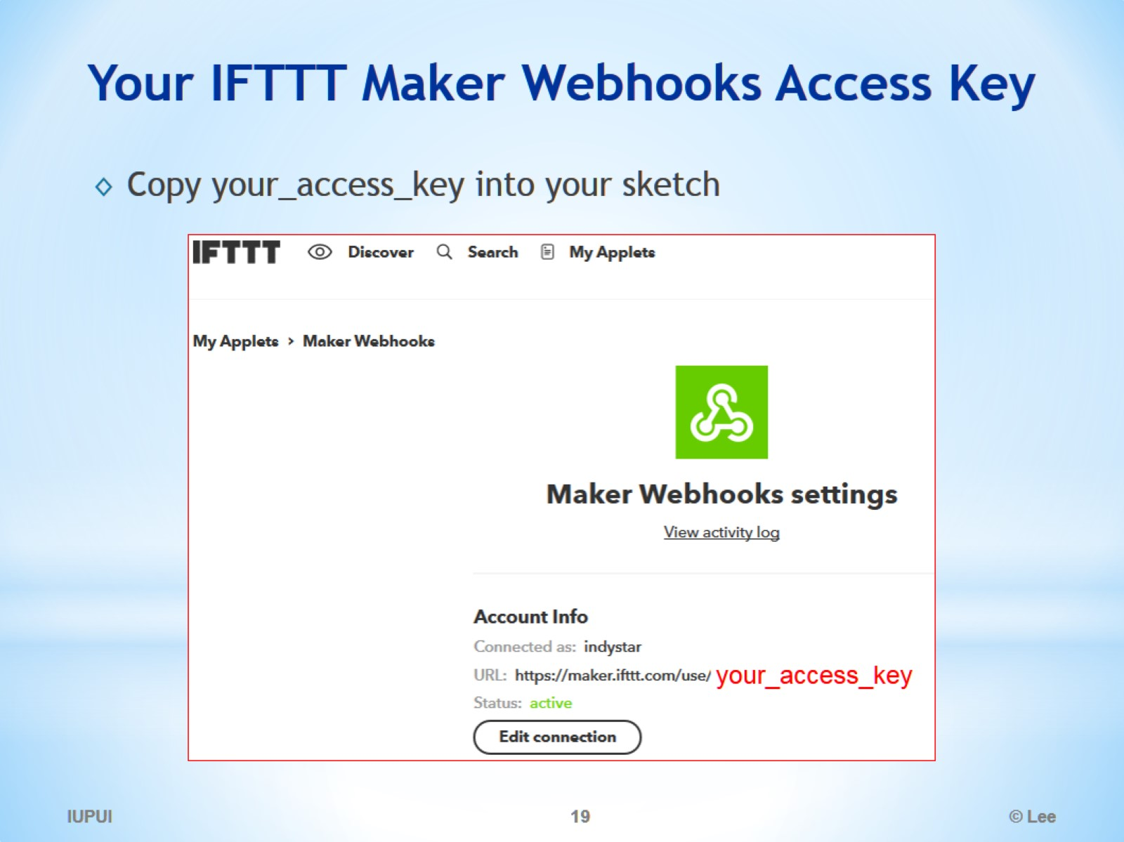
Your IFTTT Maker Webhooks Access Key

Slide 20
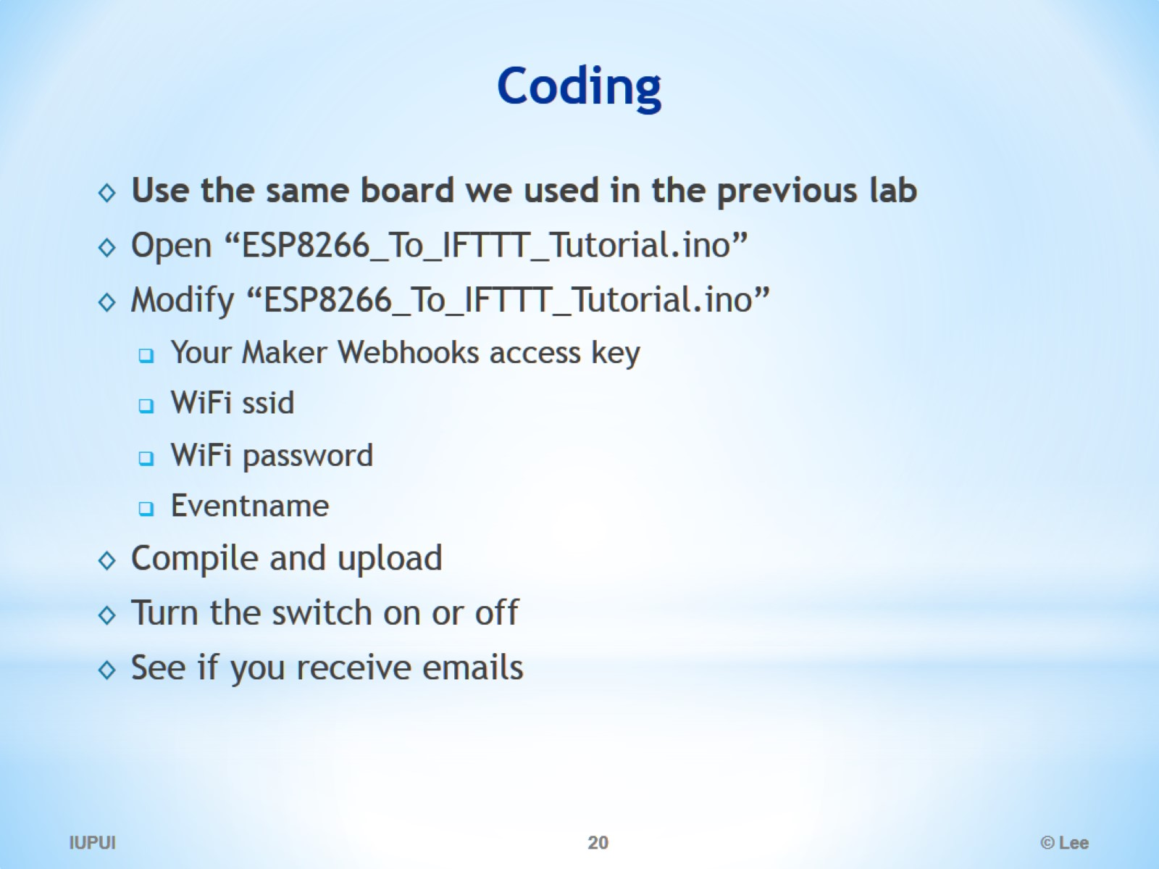
Coding

Slide 21
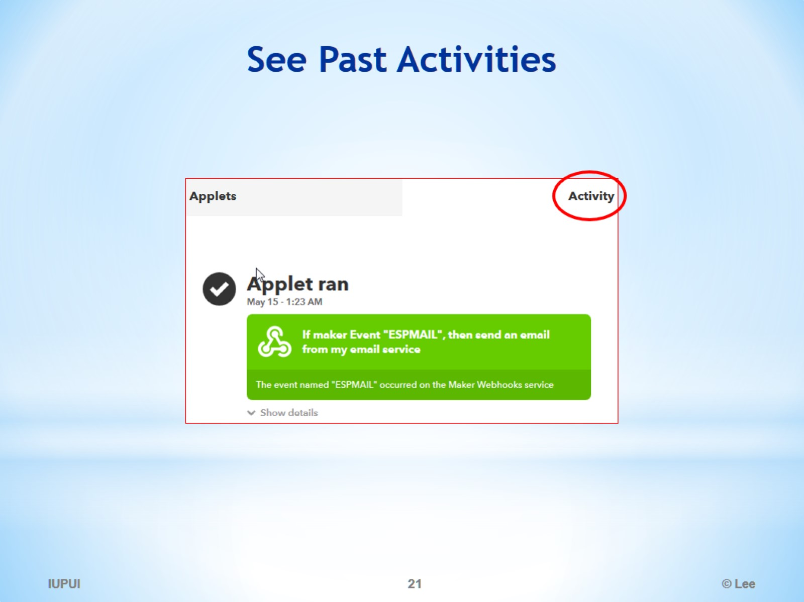
See Past Activities

Slide 22
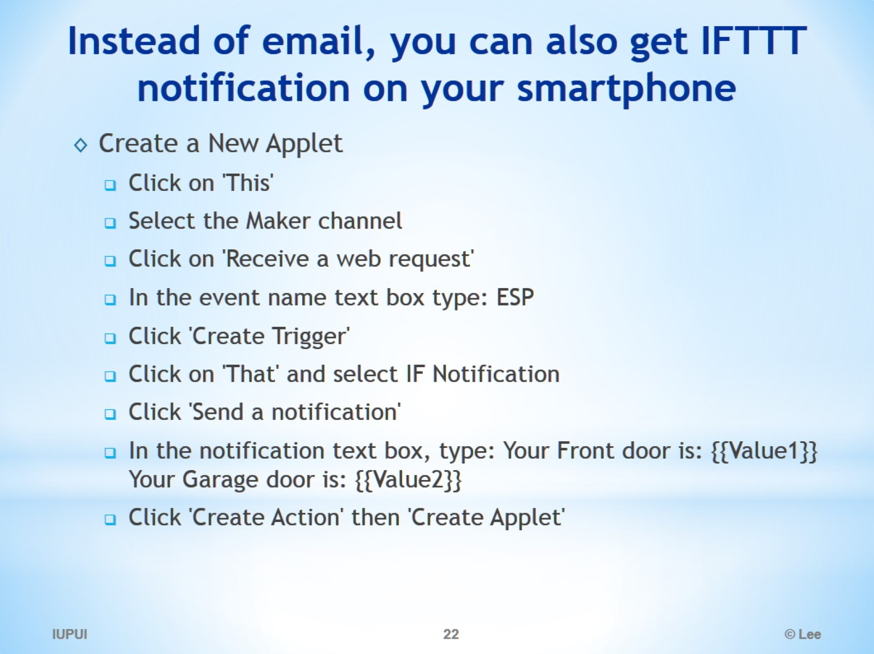
Instead of email, you can also get IFTTT notification on your smartphone

Slide 23
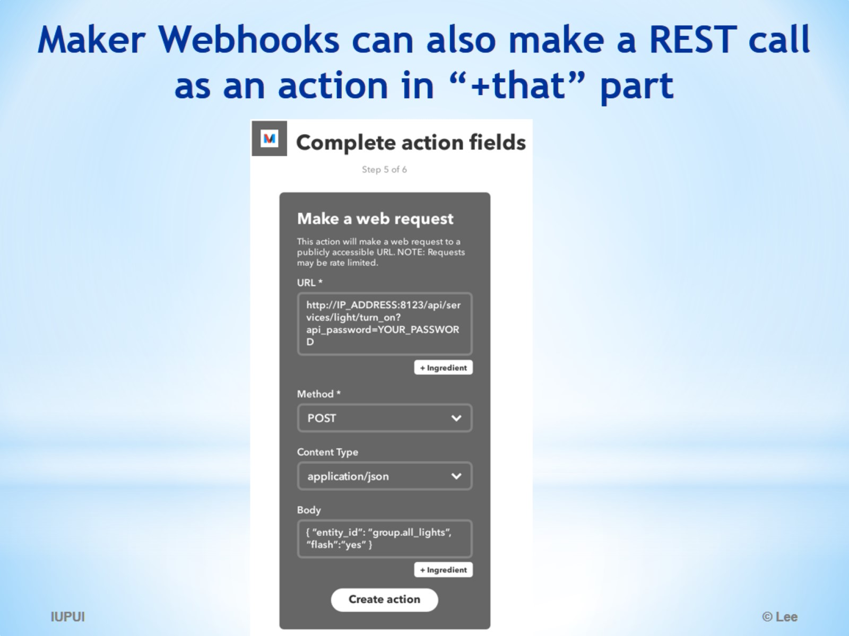
Maker Webhooks can also make a REST call as an action in “+that” part

Slide 24
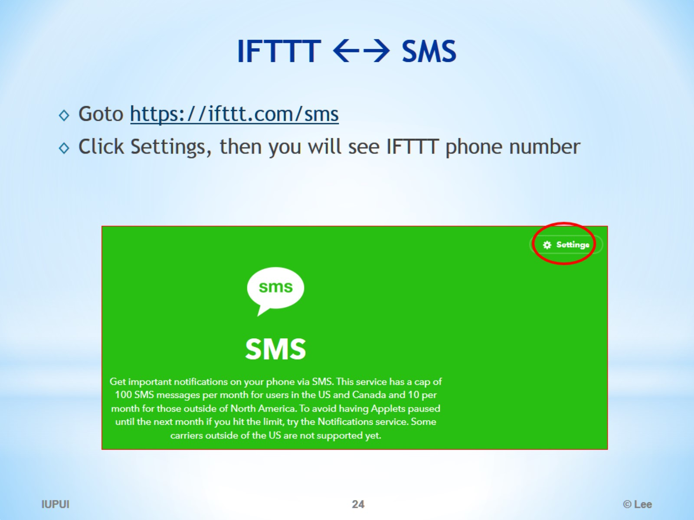
IFTTT ←→ SMS

